Slide 1
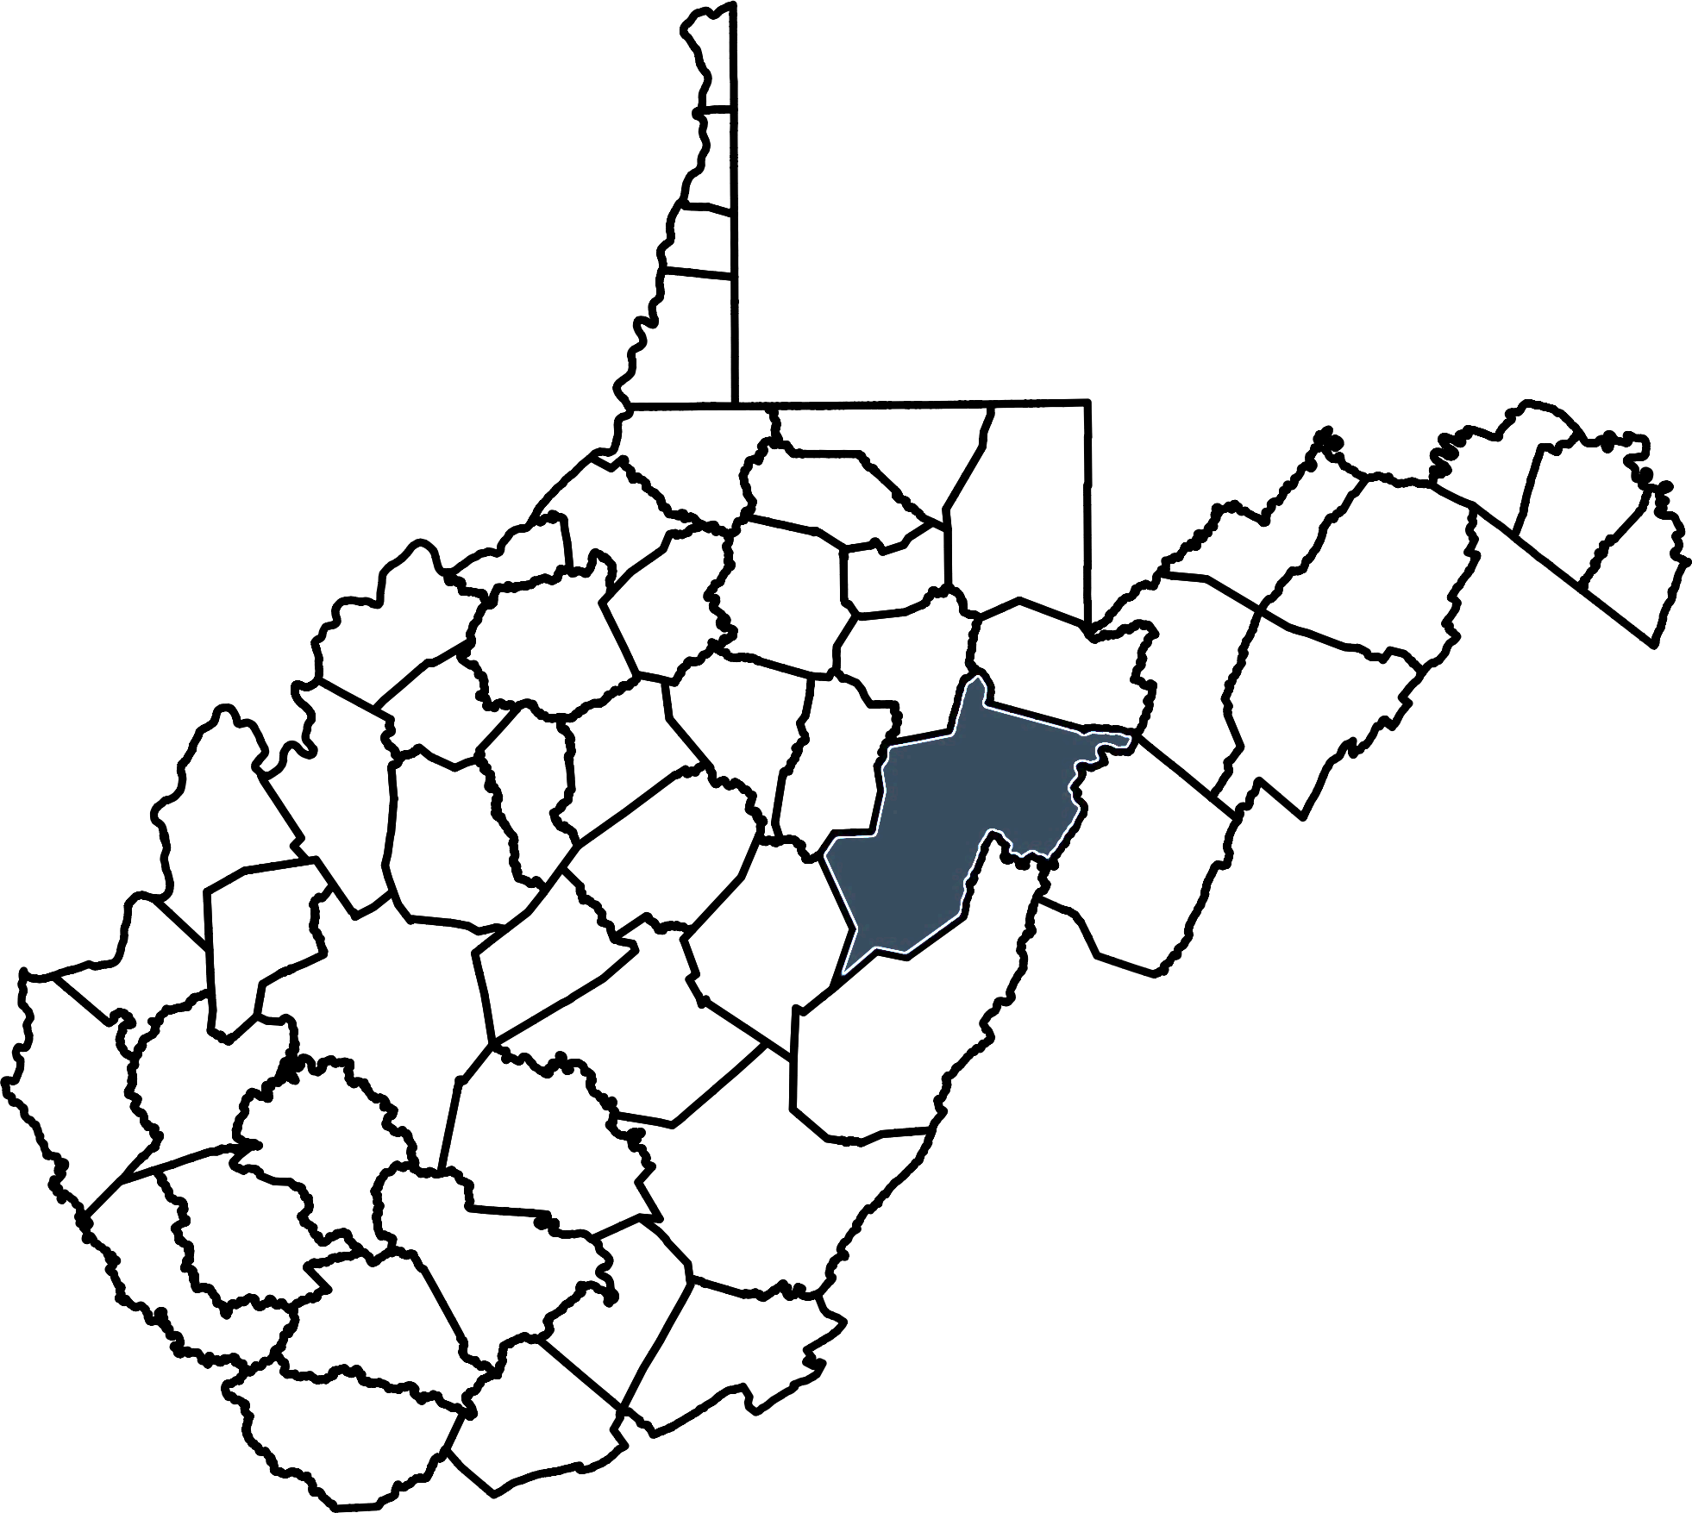
Superintendent’s Updates
July 16, 2024

Slide 2
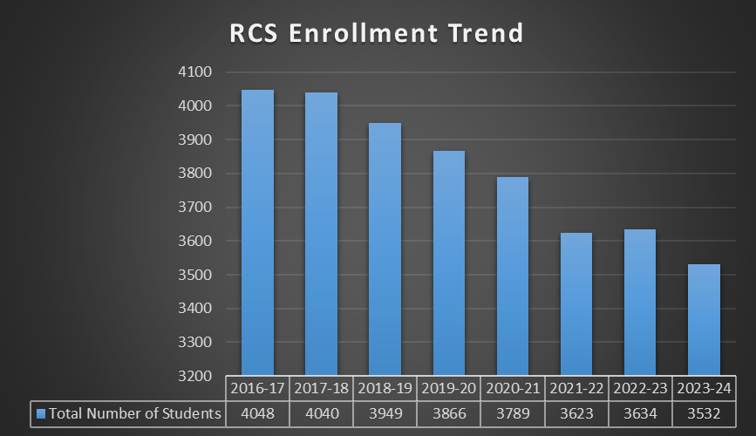
Enrollment Trend
Past 8 Years
2016-17 to 2023-24
4048 - 3532 = 516
For every
12 – 14.5 students lost RCS loses the funding for a teacher.
516 ÷ 13.25 =
38.94
Notes:
3532-3271 = 261 students
261/13.25 = 19.7

Slide 3
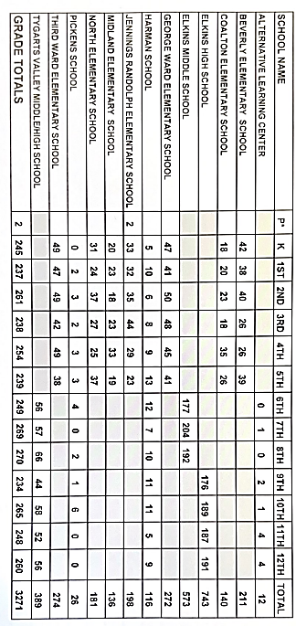
RCS Enrollment July 1, 2024
2023-24 to 2024-25
3532 - 3271 = 261
For every
12 – 14.5 students lost RCS loses the funding for a teacher.
261 ÷ 13.25 =
19.7
Notes:
3532-3271 = 261 students
261/13.25 = 19.7

Slide 4
Per Pupil Expenditures
RCS Average
Per Pupil Expenditure
2022-23
$12,848.36
State Average
Per Pupil Expenditure
2022-23
$14,559.54

Slide 5
Per Pupil Expenditures
$22,387.49 | PICKENS ELEMENTARY/HIGH SCHOOL
$16,214.65 | HARMAN ELEMENTARY/HIGH SCHOOL
$15,725.88 | RANDOLPH COUNTY ALTERNATIVE CENTER
$15,021.97 | MIDLAND ELEMENTARY SCHOOL
$13,671.79 | ELKINS THIRD WARD ELEMENTARY SCHOOL
$13,642.73 | COALTON ELEMENTARY SCHOOL
$13,528.86 | NORTH ELEMENTARY SCHOOL
$13,352.33 | JENNINGS RANDOLPH ELEMENTARY SCHOOL
$13,194.90 | BEVERLY ELEMENTARY SCHOOL
$13,102.29 | TYGARTS VALLEY MIDDLE/HIGH SCHOOL
$12,692.55 | GEORGE WARD ELEMENTARY SCHOOL
$12,110.04 | ELKINS MIDDLE SCHOOL
$10,857.24 | ELKINS HIGH SCHOOL
RCS Average
Per Pupil Expenditure
2022-23
$12,848.36

Slide 6
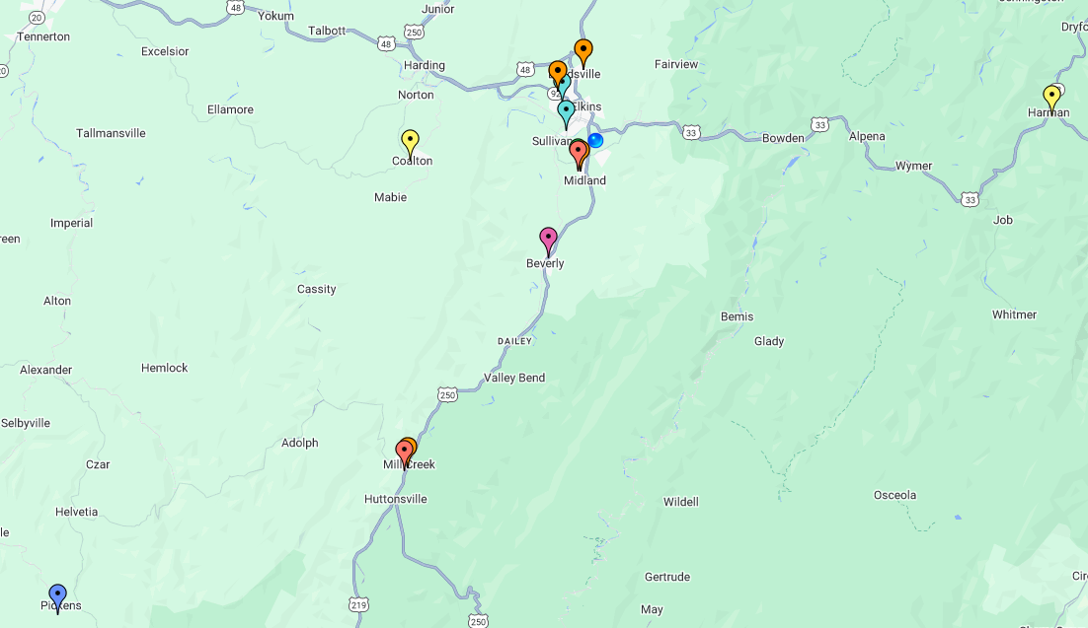
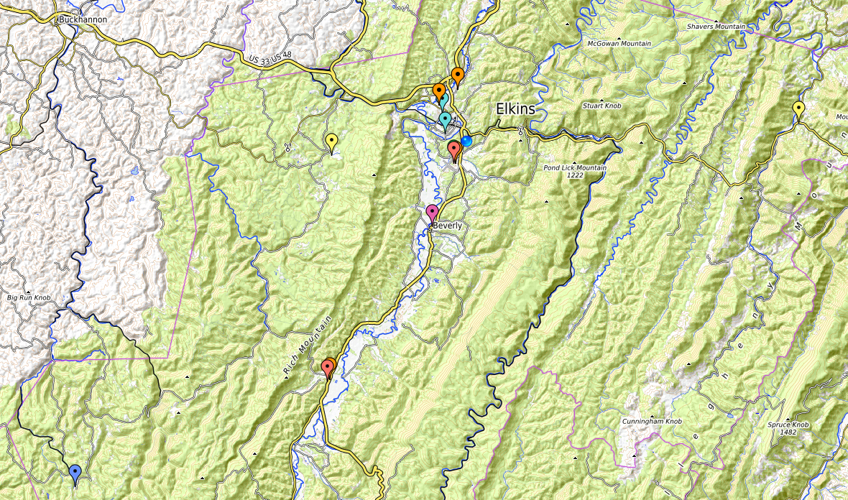
RCS

Slide 7
Questions?

